Slide 1
Chapter 17 Distributed Coordination
Event Ordering
Mutual Exclusion
Atomicity
Concurrency Control
Deadlock Handling
Election Algorithms
Reaching Agreement

Slide 2
Event Ordering
Happened-before relation (denoted by →).
  If A and B are events in the same process, and A was executed before B, then A → B.
  If A is the event of sending a message by one process and B is the event of receiving that message by another process, then A → B.
  If A → B and B → C then A → C.

Slide 3
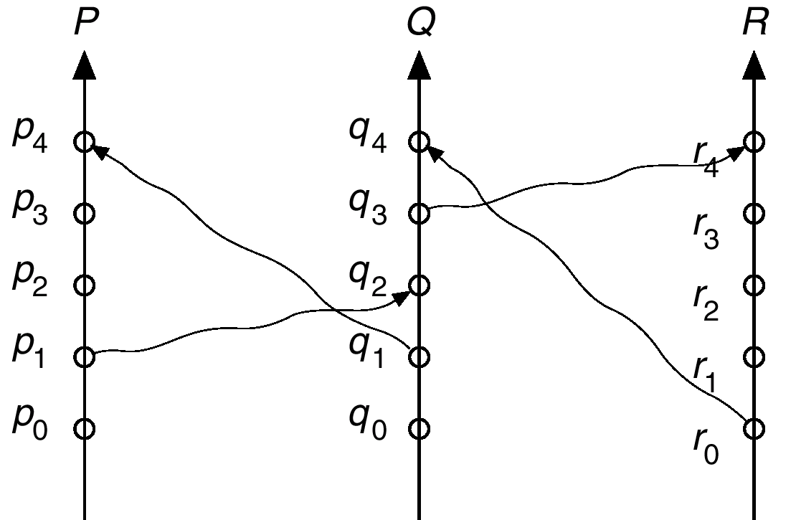
Relative Time for Three Concurrent Processes

Slide 4
Implementation of →
Associate a timestamp with each system event. Require that for every pair of events A and B, if A → B, then the timestamp of A is less than the timestamp of B.
Within each process P_{i} a logical clock, LC_{i} is associated. The logical clock can be implemented as a simple counter that is incremented between any two successive events executed within a process.
A process advances its logical clock when it receives a message whose timestamp is greater than the current value of its logical clock.
If the timestamps of two events A and B are the same, then the events are concurrent. We may use the process identity numbers to break ties and to create a total ordering.

Slide 5
Distributed Mutual Exclusion (DME)
Assumptions
  The system consists of n processes; each process P_{i} resides at a different processor.
  Each process has a critical section that requires mutual exclusion.
Requirement
  If P_{i} is executing in its critical section, then no other process P_{j} is executing in its critical section.
We present two algorithms to ensure the mutual exclusion execution of processes in their critical sections.

Slide 6
DME: Centralized Approach
One of the processes in the system is chosen to coordinate the entry to the critical section.
A process that wants to enter its critical section sends a request message to the coordinator.
The coordinator decides which process can enter the critical section next, and its sends that process a reply message.
When the process receives a reply message from the coordinator, it enters its critical section.
After exiting its critical section, the process sends a release message to the coordinator and proceeds with its execution.
This scheme requires three messages per critical-section entry:
  request
  reply
  release

Slide 7
DME: Fully Distributed Approach
When process P_{i} wants to enter its critical section, it generates a new timestamp, TS, and sends the message request (P_{i}, TS) to all other processes in the system.
When process P_{j} receives a request message, it may reply immediately or it may defer sending a reply back.
When process P_{i} receives a reply message from all other processes in the system, it can enter its critical section.
After exiting its critical section, the process sends reply messages to all its deferred requests.

Slide 8
DME: Fully Distributed Approach (Cont.)
The decision whether process P_{j} replies immediately to a request(P_{i}, TS) message or defers its reply is based on three factors:
  If P_{j} is in its critical section, then it defers its reply to P_{i}.
  If P_{j} does not want to enter its critical section, then it sends a reply immediately to P_{i}.
  If P_{j} wants to enter its critical section but has not yet entered it, then it compares its own request timestamp with the timestamp TS.
    If its own request timestamp is greater than TS, then it sends a reply immediately to P_{i} (P_{i} asked first).
    Otherwise, the reply is deferred.

Slide 9
Desirable Behavior of Fully Distributed Approach
Freedom from Deadlock is ensured.
Freedom from starvation is ensured, since entry to the critical section is scheduled according to the timestamp ordering. The timestamp ordering ensures that processes are served in a first-come, first served order.
The number of messages per critical-section entry is
2 x (n – 1).
This is the minimum number of required messages per critical-section entry when processes act independently and concurrently.

Slide 10
Three Undesirable Consequences
The processes need to know the identity of all other processes in the system, which makes the dynamic addition and removal of processes more complex.
If one of the processes fails, then the entire scheme collapses. This can be dealt with by continuously monitoring the state of all the processes in the system.
Processes that have not entered their critical section must pause frequently to assure other processes that they intend to enter the critical section. This protocol is therefore suited for small, stable sets of cooperating processes.

Slide 11
Atomicity
Either all the operations associated with a program unit are executed to completion, or none are performed.
Ensuring atomicity in a distributed system requires a transaction coordinator, which is responsible for the following:
  Starting the execution of the transaction.
  Breaking the transaction into a number of subtransactions, and distribution these subtransactions to the appropriate sites for execution.
  Coordinating the termination of the transaction, which may result in the transaction being committed at all sites or aborted at all sites.

Slide 12
Two-Phase Commit Protocol (2PC)
Assumes fail-stop model.
Execution of the protocol is initiated by the coordinator after the last step of the transaction has been reached.
When the protocol is initiated, the transaction may still be executing at some of the local sites.
The protocol involves all the local sites at which the transaction executed.
Example: Let T be a transaction initiated at site S_{i} and let the transaction coordinator at S_{i} be C_{i}.

Slide 13
Phase 1: Obtaining a Decision
C_{i} adds <prepare T> record to the log.
C_{i} sends <prepare T> message to all sites.
When a site receives a <prepare T> message, the transaction manager determines if it can commit the transaction.
  If no: add <no T> record to the log and respond to C_{i} with <abort T>.
  If yes:
    add <ready T> record to the log.
    force all log records for T onto stable storage.
    transaction manager sends <ready T> message to C_{i}.

Slide 14
Phase 1 (Cont.)
Coordinator collects responses
  All respond “ready”,
  decision is commit.
  At least one response is “abort”,
  decision is abort.
  At least one participant fails to respond within time out period,
  decision is abort.

Slide 15
Phase 2: Recording Decision in the Database
Coordinator adds a decision record
<abort T> or <commit T>
to its log and forces record onto stable storage.
Once that record reaches stable storage it is irrevocable (even if failures occur).
Coordinator sends a message to each participant informing it of the decision (commit or abort).
Participants take appropriate action locally.

Slide 16
Failure Handling in 2PC – Site Failure
The log contains a <commit T> record. In this case, the site executes redo(T).
The log contains an <abort T> record. In this case, the site executes undo(T).
The contains a <ready T> record; consult C_{i}. If C_{i} is down, site sends query-status T message to the other sites.
The log contains no control records concerning T. In this case, the site executes undo(T).

Slide 17
Failure Handling in 2PC – Coordinator C_{i} Failure
If an active site contains a <commit T> record in its log, the T must be committed.
If an active site contains an <abort T> record in its log, then T must be aborted.
If some active site does not contain the record <ready T> in its log then the failed coordinator C_{i} cannot have decided to
commit T. Rather than wait for C_{i} to recover, it is preferable to abort T.
All active sites have a <ready T> record in their logs, but no additional control records. In this case we must wait for the coordinator to recover.
  Blocking problem – T is blocked pending the recovery of site S_{i}.

Slide 18
Concurrency Control
Modify the centralized concurrency schemes to accommodate the distribution of transactions.
Transaction manager coordinates execution of transactions (or subtransactions) that access data at local sites.
Local transaction only executes at that site.
Global transaction executes at several sites.

Slide 19
Locking Protocols
Can use the two-phase locking protocol in a distributed environment by changing how the lock manager is implemented.
Nonreplicated scheme – each site maintains a local lock manager which administers lock and unlock requests for those data items that are stored in that site.
  Simple implementation involves two message transfers for handling lock requests, and one message transfer for handling unlock requests.
  Deadlock handling is more complex.

Slide 20
Single-Coordinator Approach
A single lock manager resides in a single chosen site, all lock and unlock requests are made a that site.
Simple implementation
Simple deadlock handling
Possibility of bottleneck
Vulnerable to loss of concurrency controller if single site fails
Multiple-coordinator approach distributes lock-manager function over several sites.

Slide 21
Majority Protocol
Avoids drawbacks of central control by dealing with replicated data in a decentralized manner.
More complicated to implement
Deadlock-handling algorithms must be modified; possible for deadlock to occur in locking only one data item.

Slide 22
Biased Protocol
Similar to majority protocol, but requests for shared locks prioritized over requests for exclusive locks.
Less overhead on read operations than in majority protocol; but has additional overhead on writes.
Like majority protocol, deadlock handling is complex.

Slide 23
Primary Copy
One of the sites at which a replica resides is designated as the primary site. Request to lock a data item is made at the primary site of that data item.
Concurrency control for replicated data handled in a manner similar to that of unreplicated data.
Simple implementation, but if primary site fails, the data item is unavailable, even though other sites may have a replica.

Slide 24
Timestamping
Generate unique timestamps in distributed scheme:
  Each site generates a unique local timestamp.
  The global unique timestamp is obtained by concatenation of the unique local timestamp with the unique site identifier
  Use a logical clock defined within each site to ensure the fair generation of timestamps.
Timestamp-ordering scheme – combine the centralized concurrency control timestamp scheme with the 2PC protocol to obtain a protocol that ensures serializability with no cascading rollbacks.

Slide 25
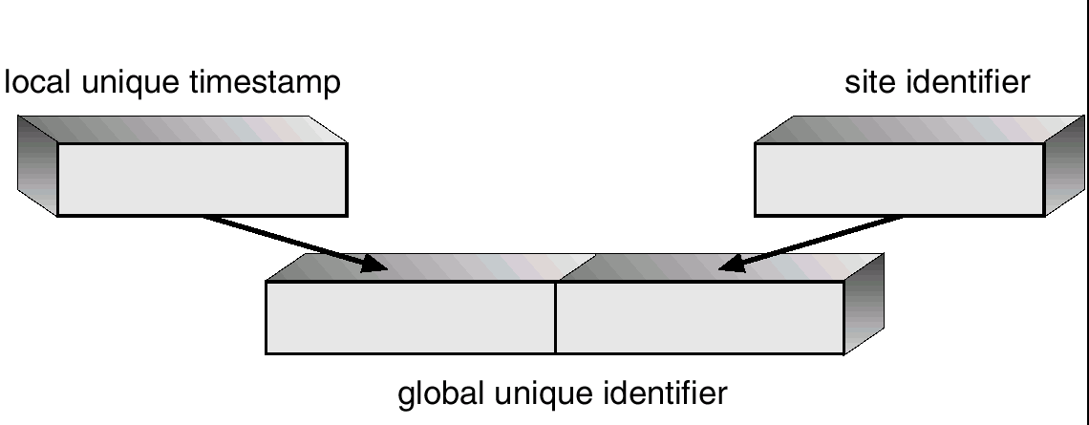
Generation of Unique Timestamps

Slide 26
Deadlock Prevention
Resource-ordering deadlock-prevention – define a global ordering among the system resources.
  Assign a unique number to all system resources.
  A process may request a resource with unique number i only if it is not holding a resource with a unique number grater than i.
  Simple to implement; requires little overhead.
Banker’s algorithm – designate one of the processes in the system as the process that maintains the information necessary to carry out the Banker’s algorithm.
  Also implemented easily, but may require too much overhead.

Slide 27
Timestamped Deadlock-Prevention Scheme
Each process P_{i} is assigned a unique priority number
Priority numbers are used to decide whether a process P_{i} should wait for a process P_{j}; otherwise P_{i} is rolled back.
The scheme prevents deadlocks. For every edge P_{i} → P_{j} in the wait-for graph, P_{i} has a higher priority than P_{j}. Thus a cycle cannot exist.

Slide 28
Wait-Die Scheme
Based on a nonpreemptive technique.
If P_{i} requests a resource currently held by P_{j}, P_{i} is allowed to wait only if it has a smaller timestamp than does P_{j} (P_{i} is older than P_{j}). Otherwise, P_{i} is rolled back (dies).
Example: Suppose that processes P₁, P₂, and P₃ have timestamps t, 10, and 15 respectively.
  if P₁ request a resource held by P₂, then P₁ will wait.
  If P₃ requests a resource held by P₂, then P₃ will be rolled back.

Slide 29
Would-Wait Scheme
Based on a preemptive technique; counterpart to the wait-die system.
If P_{i} requests a resource currently held by P_{j}, P_{i} is allowed to wait only if it has a larger timestamp than does P_{j} (P_{i} is younger than P_{j}). Otherwise P_{j} is rolled back (P_{j} is wounded by P_{i}).
Example: Suppose that processes P₁, P_{2,} and P₃ have timestamps 5, 10, and 15 respectively.
  If P₁ requests a resource held by P₂, then the resource will be preempted from P₂ and P₂ will be rolled back.
  If P₃ requests a resource held by P₂, then P₃ will wait.

Slide 30
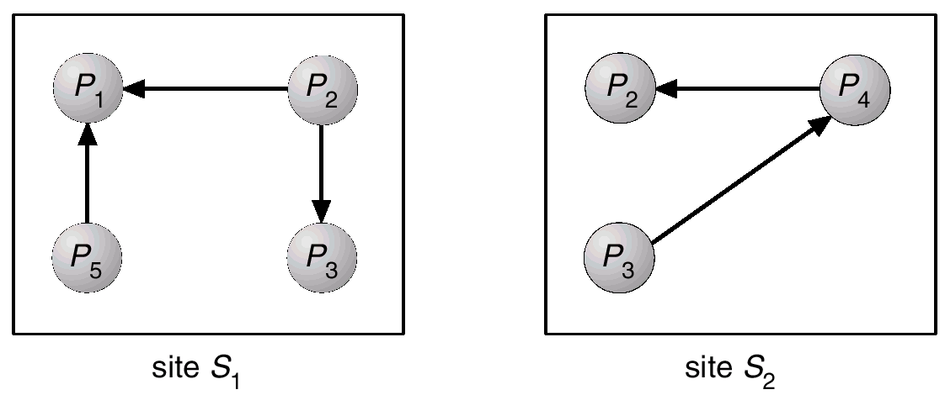
Two Local Wait-For Graphs

Slide 31
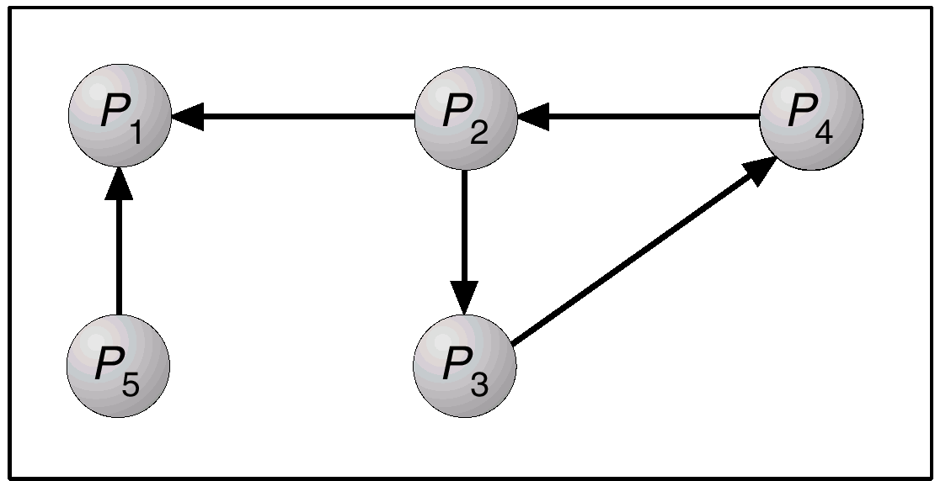
Global Wait-For Graph

Slide 32
Deadlock Detection – Centralized Approach
Each site keeps a local wait-for graph. The nodes of the graph correspond to all the processes that are currently either holding or requesting any of the resources local to that site.
A global wait-for graph is maintained in a single coordination process; this graph is the union of all local wait-for graphs.
There are three different options (points in time) when the wait-for graph may be constructed:
  1. Whenever a new edge is inserted or removed in one of the local wait-for graphs.
  2. Periodically, when a number of changes have occurred in a wait-for graph.
  3. Whenever the coordinator needs to invoke the cycle-detection algorithm..
Unnecessary rollbacks may occur as a result of false cycles.

Slide 33
Detection Algorithm Based on Option 3
Append unique identifiers (timestamps) to requests form different sites.
When process P_{i}, at site A, requests a resource from process P_{j}, at site B, a request message with timestamp TS is sent.
The edge P_{i} → P_{j} with the label TS is inserted in the local wait-for of A. The edge is inserted in the local wait-for graph of B only if B has received the request message and cannot immediately grant the requested resource.

Slide 34
The Algorithm
1. The controller sends an initiating message to each site in the system.
2. On receiving this message, a site sends its local wait-for graph to the coordinator.
3. When the controller has received a reply from each site, it constructs a graph as follows:
  (a) The constructed graph contains a vertex for every process in the system.
  (b) The graph has an edge P_{i} → P_{j} if and only if (1) there is an edge P_{i} → P_{j} in one of the wait-for graphs, or (2) an edge P_{i} → P_{j} with some label TS appears in more than one wait-for graph.
  If the constructed graph contains a cycle ⇒ deadlock.

Slide 35
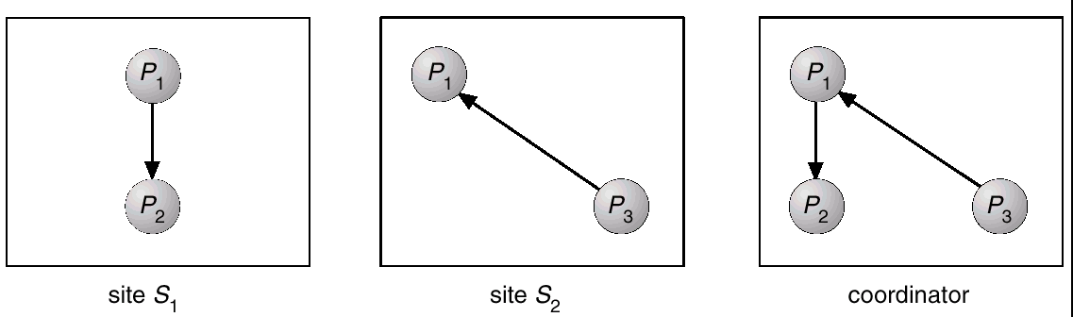
Local and Global Wait-For Graphs

Slide 36
Fully Distributed Approach
All controllers share equally the responsibility for detecting deadlock.
Every site constructs a wait-for graph that represents a part of the total graph.
We add one additional node P_{ex} to each local wait-for graph.
If a local wait-for graph contains a cycle that does not involve node P_{ex}, then the system is in a deadlock state.
A cycle involving P_{ex} implies the possibility of a deadlock. To ascertain whether a deadlock does exist, a distributed deadlock-detection algorithm must be invoked.

Slide 37
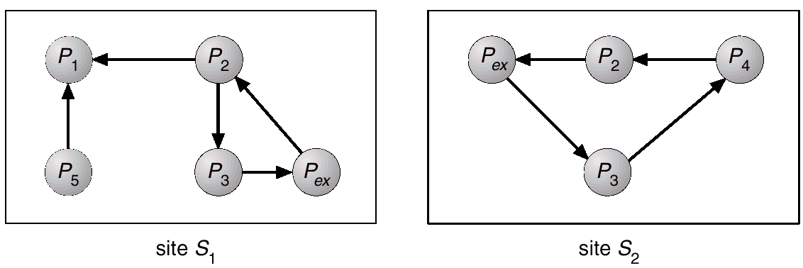
Augmented Local Wait-For Graphs

Slide 38
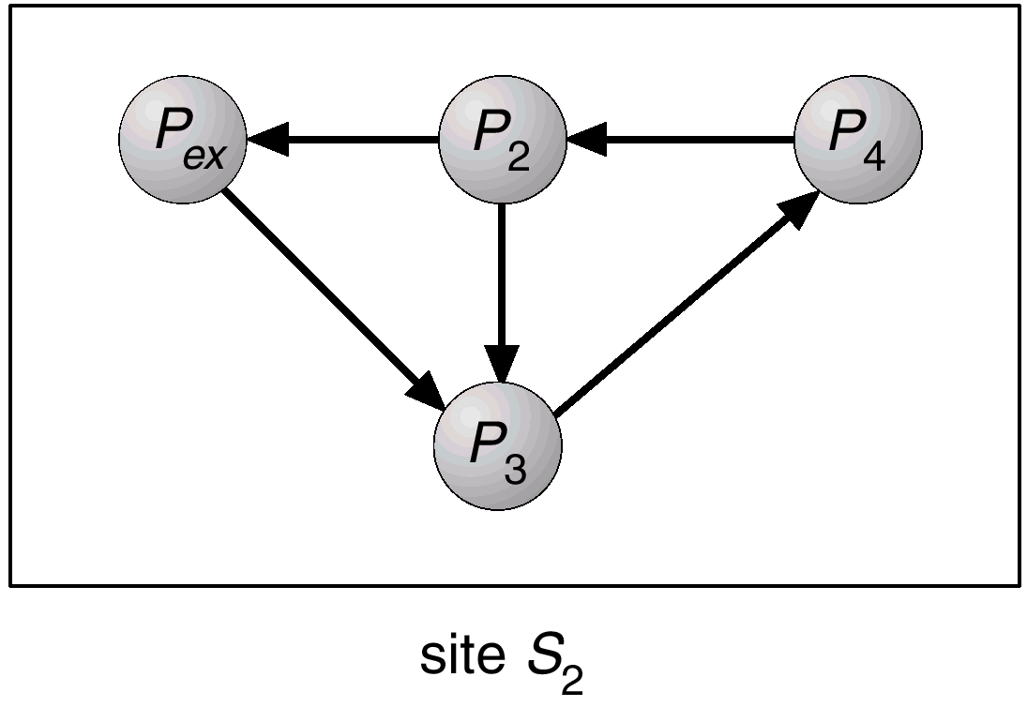
Augmented Local Wait-For Graph in Site S2

Slide 39
Election Algorithms
Determine where a new copy of the coordinator should be restarted.
Assume that a unique priority number is associated with each active process in the system, and assume that the priority number of process P_{i} is i.
Assume a one-to-one correspondence between processes and sites.
The coordinator is always the process with the largest priority number. When a coordinator fails, the algorithm must elect that active process with the largest priority number.
Two algorithms, the bully algorithm and a ring algorithm, can be used to elect a new coordinator in case of failures.

Slide 40
Bully Algorithm
Applicable to systems where every process can send a message to every other process in the system.
If process P_{i} sends a request that is not answered by the coordinator within a time interval T, assume that the coordinator has failed; P_{i} tries to elect itself as the new coordinator.
P_{i} sends an election message to every process with a higher priority number, P_{i} then waits for any of these processes to answer within T.

Slide 41
Bully Algorithm (Cont.)
If no response within T, assume that all processes with numbers greater than i have failed; P_{i} elects itself the new coordinator.
If answer is received, P_{i} begins time interval T´, waiting to receive a message that a process with a higher priority number has been elected.
If no message is sent within T´, assume the process with a higher number has failed; P_{i} should restart the algorithm

Slide 42
Bully Algorithm (Cont.)
If P_{i} is not the coordinator, then, at any time during execution, P_{i} may receive one of the following two messages from process P_{j}.
  P_{j} is the new coordinator (j > i). P_{i}, in turn, records this information.
  P_{j} started an election (j > i). P_{i}, sends a response to P_{j} and begins its own election algorithm, provided that Pi has not already initiated such an election.
After a failed process recovers, it immediately begins execution of the same algorithm.
If there are no active processes with higher numbers, the recovered process forces all processes with lower number to let it become the coordinator process, even if there is a currently active coordinator with a lower number.

Slide 43
Ring Algorithm
Applicable to systems organized as a ring (logically or physically).
Assumes that the links are unidirectional, and that processes send their messages to their right neighbors.
Each process maintains an active list, consisting of all the priority numbers of all active processes in the system when the algorithm ends.
If process P_{i} detects a coordinator failure, I creates a new active list that is initially empty. It then sends a message elect(i) to its right neighbor, and adds the number i to its active list.

Slide 44
Ring Algorithm (Cont.)
If P_{i} receives a message elect(j) from the process on the left, it must respond in one of three ways:
  1. If this is the first elect message it has seen or sent, P_{i} creates a new active list with the numbers i and j. It then sends the message elect(i), followed by the message elect(j).
  If i ≠ j, then the active list for P_{i} now contains the numbers of all the active processes in the system. P_{i} can now determine the largest number in the active list to identify the new coordinator process.
  If i = j, then P_{i} receives the message elect(i). The active list for P_{i} contains all the active processes in the system. P_{i} can now determine the new coordinator process.

Slide 45
Reaching Agreement
There are applications where a set of processes wish to agree on a common “value”.
Such agreement may not take place due to:
  Faulty communication medium
  Faulty processes
    Processes may send garbled or incorrect messages to other processes.
    A subset of the processes may collaborate with each other in an attempt to defeat the scheme.

Slide 46
Faulty Communications
Process P_{i} at site A, has sent a message to process P_{j} at site B; to proceed, P_{i} needs to know if P_{j} has received the message.
Detect failures using a time-out scheme.
  When P_{i} sends out a message, it also specifies a time interval during which it is willing to wait for an acknowledgment message form P_{j}.
  When P_{j} receives the message, it immediately sends an acknowledgment to P_{i}.
  If P_{i} receives the acknowledgment message within the specified time interval, it concludes that P_{j} has received its message. If a time-out occurs, P_{j} needs to retransmit its message and wait for an acknowledgment.
  Continue until P_{i} either receives an acknowledgment, or is notified by the system that B is down.

Slide 47
Faulty Communications (Cont.)
Suppose that P_{j} also needs to know that P_{i} has received its acknowledgment message, in order to decide on how to proceed.
  In the presence of failure, it is not possible to accomplish this task.
  It is not possible in a distributed environment for processes P_{i} and P_{j} to agree completely on their respective states.

Slide 48
Faulty Processes (Byzantine Generals Problem)
Communication medium is reliable, but processes can fail in unpredictable ways.
Consider a system of n processes, of which no more than m are faulty. Suppose that each process P_{i} has some private value of V_{i}.
Devise an algorithm that allows each nonfaulty P_{i} to construct a vector X_{i} = (A_{i,1}, A_{i,2}, …, A_{i,n}) such that::
  If P_{j} is a nonfaulty process, then A_{ij} = V_{j.}
  If P_{i} and P_{j} are both nonfaulty processes, then X_{i} = X_{j}.
Solutions share the following properties.
  A correct algorithm can be devised only if n ≥ 3 x m + 1.
  The worst-case delay for reaching agreement is proportionate to m + 1 message-passing delays.

Slide 49
Faulty Processes (Cont.)
An algorithm for the case where m = 1 and n = 4 requires two rounds of information exchange:
  Each process sends its private value to the other 3 processes.
  Each process sends the information it has obtained in the first round to all other processes.
If a faulty process refuses to send messages, a nonfaulty process can choose an arbitrary value and pretend that that value was sent by that process.
After the two rounds are completed, a nonfaulty process P_{i} can construct its vector X_{i} = (A_{i,1}, A_{i,2}, A_{i,3}, A_{i,4}) as follows:
  A_{i,j} = V_{i}.
  For j ≠ i, if at least two of the three values reported for process P_{j} agree, then the majority value is used to set the value of A_{ij}. Otherwise, a default value (nil) is used.

